Slide 1
ECON 3510 International Trade Theory and Policy
The Specific Factors Model
Tutorial 5
Notes:
If this PowerPoint presentation contains mathematical equations, you may need to check that your computer has the following installed:
1) MathType Plugin
2) Math Player (free versions available)
3) NVDA Reader (free versions available)

Slide 2
Recap of Lecture 5
Winners and loser from trade in the specific factors model: (a) factors specific to export sectors gain; (b) factors specific to import-competing sectors lose; (c) mobile factors may either gain or lose.
Trade produces overall gains; winners could in principle compensate losers.
Better to address the problem of income distribution directly, rather than by restricting trade.
Losers are often better organized than winners, causing adoption of trade restrictions.

Slide 3
Exercise 1
In the specific factors model, suppose at Home the MPL of cloth is 100 – 2L_{C} and the MPL of food is 200 – L_{F}, where L_{C} is employment in cloth production and L_{F} is employment in food production. Suppose total labor supply is L = 200.
Assume the prices of food and cloth are P_{F} = 1, P_{C} = 2. Compute the equilibrium wage and the employment levels in cloth and food production.
Suppose the prices of food and cloth double. What happens to employment in the two sectors and to the wage?
Suppose the price of food doubles while the price of cloth stays the same. What happens to employment in the two sectors and to the wage?

Slide 4
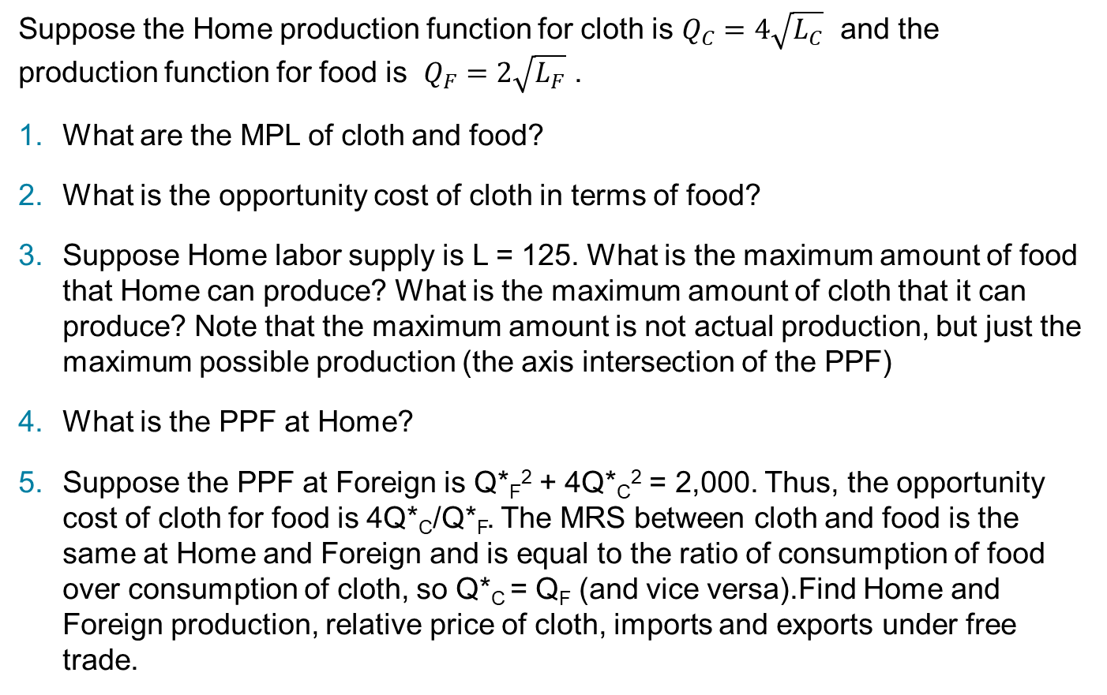
Exercise 2
Suppose the Home production function for cloth is $Q_{C}=4\sqrt{L_{C}}$ and the production function for food is $Q_{F}=2\sqrt{L_{F}}$ .
What are the MPL of cloth and food?
What is the opportunity cost of cloth in terms of food?
Suppose Home labor supply is L = 125. What is the maximum amount of food that Home can produce? What is the maximum amount of cloth that it can produce? Note that the maximum amount is not actual production, but just the maximum possible production (the axis intersection of the PPF)
What is the PPF at Home?
Suppose the PPF at Foreign is Q*_{F}² + 4Q*_{C}² = 2,000. Thus, the opportunity cost of cloth for food is 4Q*_{C}/Q*_{F}. The MRS between cloth and food is the same at Home and Foreign and is equal to the ratio of consumption of food over consumption of cloth, so Q*_{C} = Q_{F} (and vice versa).Find Home and Foreign production, relative price of cloth, imports and exports under free trade.

Slide 5
Exercise 3
The lecture argues that there is no evidence of a positive correlation between unemployment and imports (relative to GDP) for the U.S.
What about Australia?
Focus on the manufacturing sector.
Frame the discussion in relationship to the trade models studied so far.

Slide 6
Consider first this publication from the Office of the Chief Economist: https://www.industry.gov.au/sites/default/files/June%202018/document/pdf/impact-of-international-trade-on-employment_-_evidence_from_australian_manufacturing_industries.pdf?acsf_files_redirect
Key points
Manufacturing employment in Australia has declined both in absolute and relative terms over the past four decades.
Employment decreased in all industries except food, beverage and tobacco manufacturing (FBT). Job losses have been severe in textile, clothing, footwear and leather manufacturing (TCF) and machinery and equipment manufacturing .
Manufactured goods dominate Australia’s import basket; on average, over 80 per cent of Australia’s imports by value are manufactured goods.
In 2015 around half of Australia’s manufactured imports by value are sourced from low-wage countries—up from less than 10 per cent four decades ago.
Trade has a significant impact on employment, although the intensity of the impact varies by industry and has lessened over time.
Employment in industries immune from foreign competition is less responsive to wages.

Slide 7
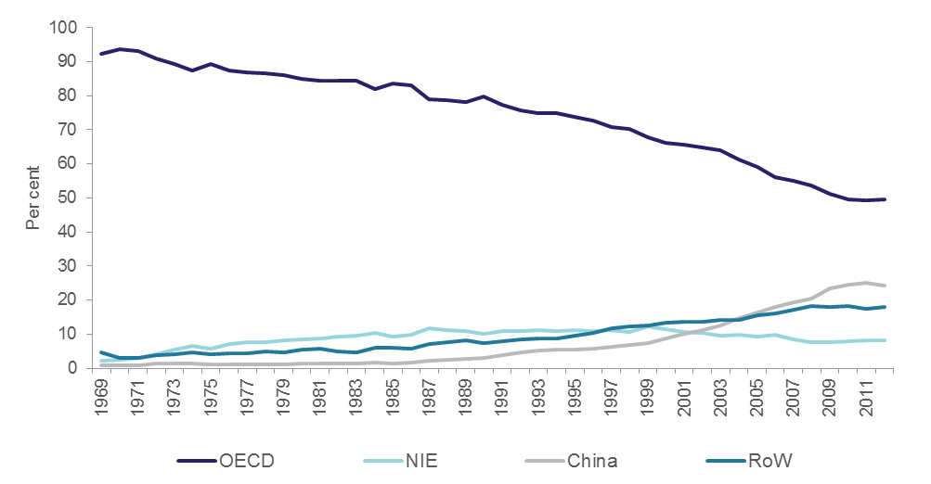
Figure 3.2: Shares of major sources of Australia’s manufactures imports, 1969–2012]
NIE =Hong Kong, Singapore, South Korea and Taiwan
RoW = Rest of the World OECD – High wages; China and RoW – Low wages

Slide 8
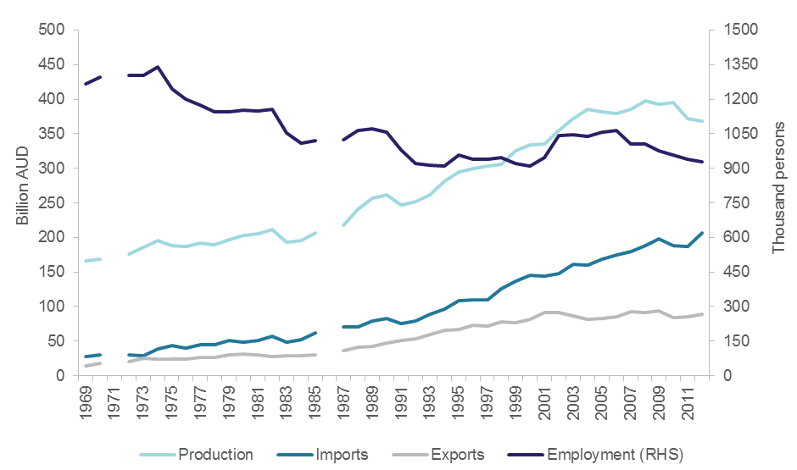
Figure 3.3: Australia’s manufacturing output, employment and trade flows, 1969–2012
Source: Productivity Commission (PC) and Australian Bureau of Statistics (ABS).
Note: Output and trade data are in constant 2011–12 prices.

Slide 9
Consider next this publication from the Royal Bank of Australia: https://www.rba.gov.au/publications/bulletin/2016/jun/pdf/bu-0616-4.pdf
It argues that:
The trends in Australian manufacturing output and employment are not unique. Over the past 25 years, most advanced economies have seen their manufacturing sectors recede as a share of both output and employment, although Australia has generally had a lower share than many other advanced economies (Graph 3).

Slide 11
Relatively high labour costs imply that the domestic industry has a comparative disadvantage in producing homogenous, labour-intensive goods.
A common theme in recent years has been that firms have been looking to find labour productivity gains by automating some production processes. They have also been developing new products to diversify their offering. These shifts are borne out in the nature of firms’ investments; increasingly, manufacturers are investing in intellectual property rather than physical capital. Investment in intellectual property, which is comprised largely of expenditure on computer software and R&D, has increased throughout the economy, although the growth in both levels and as a share of sectoral investment has been stronger in the manufacturing sector than most other industries.

